Slide 1
Layouts
Relative vs. Linear

Slide 2
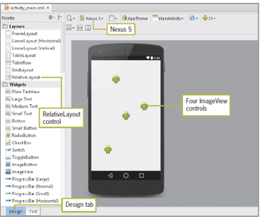
A Relative Layout organizes layout components in relation to each other
-Provides more flexibility in positioning than Linear layouts

Slide 3

About RelativeLayout
RelativeLayout is a view group that displays child views in relative positions.

Slide 4
About RelativeLayout
The position of each child view can be specified as relative to other sibling elements (such as to the left-of or below another view) or in positions relative to the parent area (such as aligned to the bottom, left of center).
layout_alignParentTop
layout_below
layout_alignParentLeft
layout_below
layout_alignParentRight

Slide 5
About RelativeLayout
By default, all child views are drawn at the top-left of the layout, so you must define the position of each view using the various layout properties.

Slide 6
About RelativeLayout
Unless you specify a vertical position/alignment, a child view will match the top of its parent.
Unless you specify a horizontal position/alignment, a child view will match the left of its parent.

Slide 7
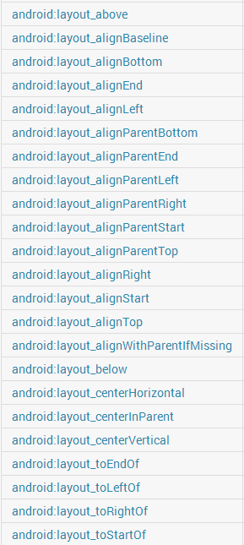
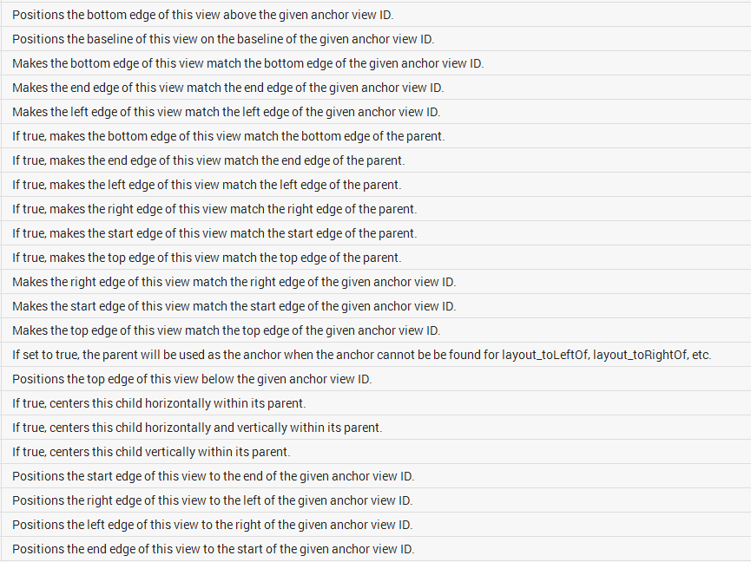
RelativeLayout Layout Parameters

Slide 8
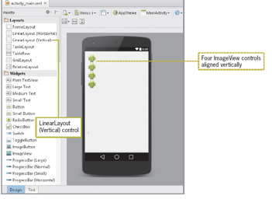
A Linear Layout organizes layout components in a vertical column or horizontal row
Can be switched from vertical to horizontal orientation

Slide 9
Horizontal Orientation
One row, many columns
Items placed beside each other
# # # # # # # # # #

Slide 10
Vertical Orientation
One column, many rows
Items stacked on top of each other
#
#
#
#
#
#

Slide 11
Use of Gravity for Linear Layouts
Two types of Gravity in Android
gravity
layout_gravity

Slide 12
android:gravity
Positions the contents of the view (what is inside the view, i.e., its contents)
Has several values:
top
bottom
left
right
center (horizontal and vertical)
center_vertical
center_horizontal

Slide 13
android:gravity
Use bit masking to combine multiple values
android:gravity="center_horizontal|bottom“
android:gravity=“top|bottom”
android:gravity=“top|right”

Slide 14
android:layout_gravity
Positions the view with respect to its parent (in its available space)
Supports same values as android:gravity

Slide 15
LinearLayout attributes
Set in opening tag either to vertical or horizontal orientation
Example:
android:orientation=“vertical”

Slide 16
What does this render?
<LinearLayout xmlns:android="http://schemas.android.com/apk/res/android"
android:orientation="vertical"
android:layout_width=“match_parent"
android:layout_height="match_parent" >
<LinearLayout
android:orientation="horizontal"
android:layout_width="wrap_content"
android:layout_height="wrap_content"
android:gravity="center" >
<TextView
android:layout_width="wrap_content"
android:layout_height="wrap_content"
android:text="@string/hello" />
<ImageView
android:layout_width="wrap_content"
android:layout_height="wrap_content"
android:src="@drawable/icon" />
</LinearLayout>
</LinearLayout>

Slide 17
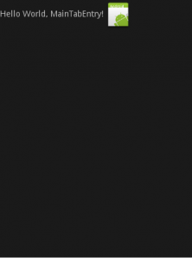
What does this render?
<?xml version="1.0" encoding="utf-8"?>
<LinearLayout xmlns:android="http://schemas.android.com/apk/res/android"
android:orientation="vertical"
android:layout_width=“match_parent"
android:layout_height="match_parent" >
<LinearLayout
android:orientation="horizontal"
android:layout_width="wrap_content"
android:layout_height="wrap_content"
android:gravity="center" >
<TextView
android:layout_width="wrap_content"
android:layout_height="wrap_content"
android:text="@string/hello" />
<ImageView
android:layout_width="wrap_content"
android:layout_height="wrap_content"
android:src="@drawable/icon" />
</LinearLayout>
</LinearLayout>

Slide 18
Why isn’t the content centered?
<?xml version="1.0" encoding="utf-8"?>
<LinearLayout xmlns:android="http://schemas.android.com/apk/res/android"
android:orientation="vertical"
android:layout_width=“match_parent"
android:layout_height="match_parent" >
<LinearLayout
android:orientation="horizontal"
android:layout_width="wrap_content"
android:layout_height="wrap_content"
android:gravity="center" >
<TextView
android:layout_width="wrap_content"
android:layout_height="wrap_content"
android:text="@string/hello" />
<ImageView
android:layout_width="wrap_content"
android:layout_height="wrap_content"
android:src="@drawable/icon" />
</LinearLayout>
</LinearLayout>

Slide 19
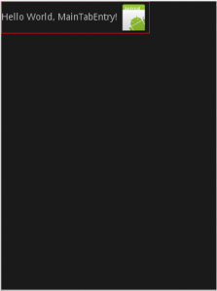
What is the width of the LinearLayout?
<?xml version="1.0" encoding="utf-8"?>
<LinearLayout xmlns:android="http://schemas.android.com/apk/res/android"
android:orientation="vertical"
android:layout_width=“match_parent"
android:layout_height="match_parent" >
<LinearLayout
android:orientation="horizontal"
android:layout_width="wrap_content"
android:layout_height="wrap_content"
android:gravity="center" >
<TextView
android:layout_width="wrap_content"
android:layout_height="wrap_content"
android:text="@string/hello" />
<ImageView
android:layout_width="wrap_content"
android:layout_height="wrap_content"
android:src="@drawable/icon" />
</LinearLayout>
</LinearLayout>

Slide 20
What is the width of the LinearLayout?
<?xml version="1.0" encoding="utf-8"?>
<LinearLayout xmlns:android="http://schemas.android.com/apk/res/android"
android:orientation="vertical"
android:layout_width=“match_parent"
android:layout_height="match_parent" >
<LinearLayout
android:orientation="horizontal"
android:layout_width="wrap_content"
android:layout_height="wrap_content"
android:gravity="center" >
<TextView
android:layout_width="wrap_content"
android:layout_height="wrap_content"
android:text="@string/hello" />
<ImageView
android:layout_width="wrap_content"
android:layout_height="wrap_content"
android:src="@drawable/icon" />
</LinearLayout>
</LinearLayout>
Because the parent LinearLayout has width “wrap_content”, it’s essentially “hugging” the two views inside and so they have no space to center themselves in.

Slide 21
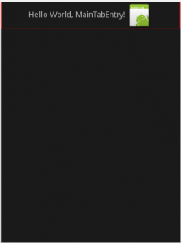
Adjust LinearLayout Width
<?xml version="1.0" encoding="utf-8"?>
<LinearLayout xmlns:android="http://schemas.android.com/apk/res/android"
android:orientation="vertical"
android:layout_width=“match_parent"
android:layout_height="match_parent" >
<LinearLayout
android:orientation="horizontal"
android:layout_width=“match_parent"
android:layout_height="wrap_content"
android:gravity="center" >
<TextView
android:layout_width="wrap_content"
android:layout_height="wrap_content"
android:text="@string/hello" />
<ImageView
android:layout_width="wrap_content"
android:layout_height="wrap_content"
android:src="@drawable/icon" />
</LinearLayout>
</LinearLayout>
A possible fix is to make the linearlayout as wide as its parent so use match_parent

Slide 22
LinearLayouts and layout_gravity
Depending on the orientation of the LinearLayout, the LinearLayout’s children can only use certain values for layout_gravity.

Slide 23
layout_gravity with horizontal orientation
For a horizontal Linear Layout the following values make sense:
top
center
Bottom
That is because the children of a horizontal Linear Layout are laid out horizontally one after the other.
With horizontal orientation, the only thing can be controlled using the android:layout_gravity is how a child view is positioned vertically.

Slide 24
layout_gravity with vertical orientaiton
For a vertical Linear Layout the following values make sense:
left
center
Right
That is because the children of a vertical Linear Layout are laid out vertically one below the other.
With vertical orientation, the only thing can be controlled using the android:layout_gravity is how a child view is positioned horizontally.

Slide 25
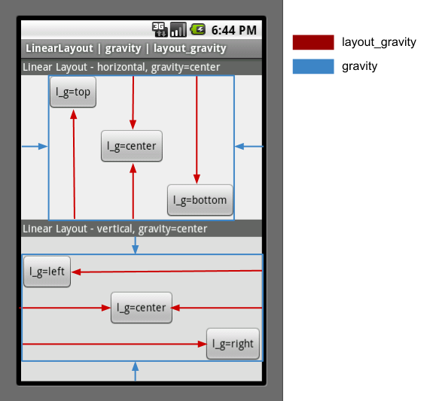
layout_gravity & gravity Example

Slide 26
layout_weight
Attribute only works (is supported)for LinearLayout
Indicates how much of the extra space in the LinearLayout will be allocated to the view associated with this attribute.

Slide 27
layout_weight
The size of the View will be determined based on the relation of all sibling’s weights to each other.
If, for example, all views define the same weight, then the available space will be distributed equally among them.

Slide 28
layout_weight
Which axis (width or height) should be affected can be controlled by setting the respective size to a value of 0dp.
Weights don’t have to add up to 1, although it’s common to distribute layout weight over all children as fractions of 1 (percentage semantics).
The relation between all weights is what matters.

Slide 29
Adding weight to multiple views
<LinearLayout … > <EditText android:layout_width="match_parent" android:layout_height="0dp" android:layout_weight = "1" android:inputType="numberSigned" android:ems="10" android:id="@+id/editText" /> <EditText android:layout_width="match_parent" android:layout_height="0dp" android:layout_weight = "2" android:inputType="numberDecimal" android:ems="10" android:id="@+id/editText2" android:layout_gravity="center_horizontal" />
</LinearLayout>

Slide 30
Common attributes to layouts
Attribute | Description
layout_width (mandatory) | specifies width of View or ViewGroup
layout_height (mandatory) | specifies height
layout_marginTop | extra space on top
layout_marginBottom | extra space on bottom side
layout_marginLeft | extra space on left side
layout_marginRight | extra space on right side
layout_gravity (for Linear) | how child views are positioned
layout_weight | how much extra space in layout should be allocated to View (only when in LinearLayout or TableView)
layout_x | x-coordinate
layout_y | y-coordinate

Slide 31

The Power of RelativeLayouts
With all the different layout parameters, one can see why RelativeLayout is super powerful.

